Slide 1
Project Question: Do lobbyist dollars affect congressional legislation?
Jennings Gamble

Slide 2
Yeah, pretty much.

Slide 4
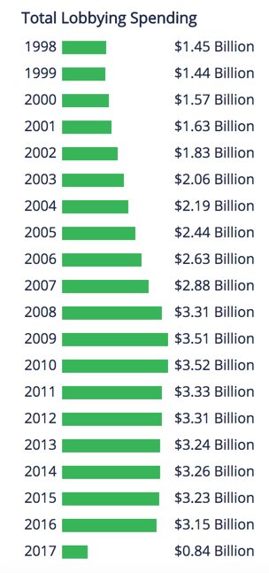

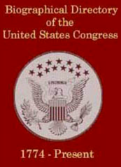

Data Sources – GovTrack

Slide 5
Methodology
BioGuide
Senator Name
GovTrack ID
Work History
GovTrack
Senator Name
GovTrackID
BioGuideID
USID (Open Secrets ID)
PVSID (VoteSmart ID)
GovTrack
Voting Record
Chart effectiveness of Lobbying dollars by industry
VoteSmart
Voting Record
OpenSecrets
Contributions by Industry

Slide 6
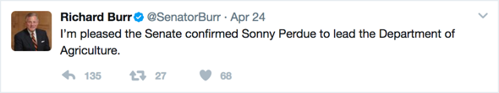
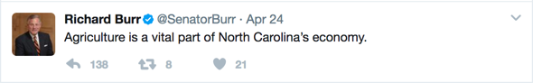
Senator Richard Burr (R-NC)
North Carolina Senior Senator, served since 2005
Previously a representative
Committee on Finance
Subcommittee on Health care
Subcommittee on Energy, Natural Resources, and Infrastructure
Subcommittee on Fiscal Responsibility and Economic Growth
Committee on Health, Education, Labor, and Pensions
Subcommittee on Employee and Workplace Safety
Subcommittee on Primary Health and Aging
Select Committee on Intelligence (Chairman)

Slide 7
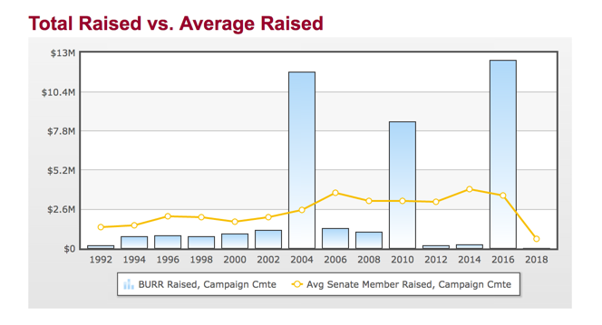
Contributions to Richard Burr
Notes:
Chart on the right is from

Slide 8
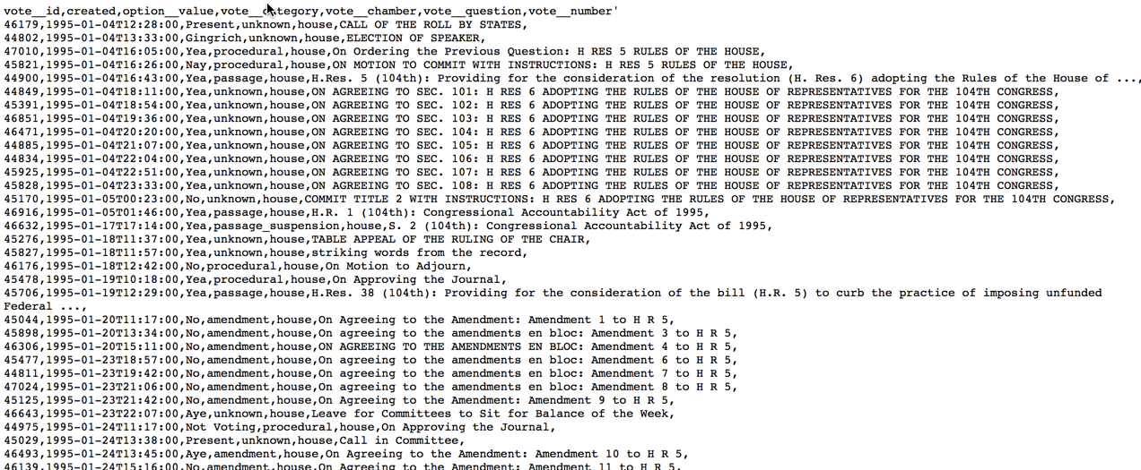
Richard Burr Voting Record (Return)

Slide 9
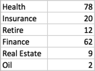
Richard Burr Voting Record
Voted on (types of bills in 114th 2015-2017 Congress):
This brings up a few problems…

Slide 10
Problems to resolve:
Limit of 200 calls/day on Open Secrets API
The OpenSecrets documentation is poor. Since the dollar amounts are so jarring, I constantly have to check with different sources.
Bills can be divided by issue area, but its hard to see what the bill is about from the title sometimes.
Drawing direct ties to certain bills from industry dollars.

